Slide 1
Intelligent Charging Station
Bastian Berle
Fabian Heidger
Ron Holzapfel

Slide 2
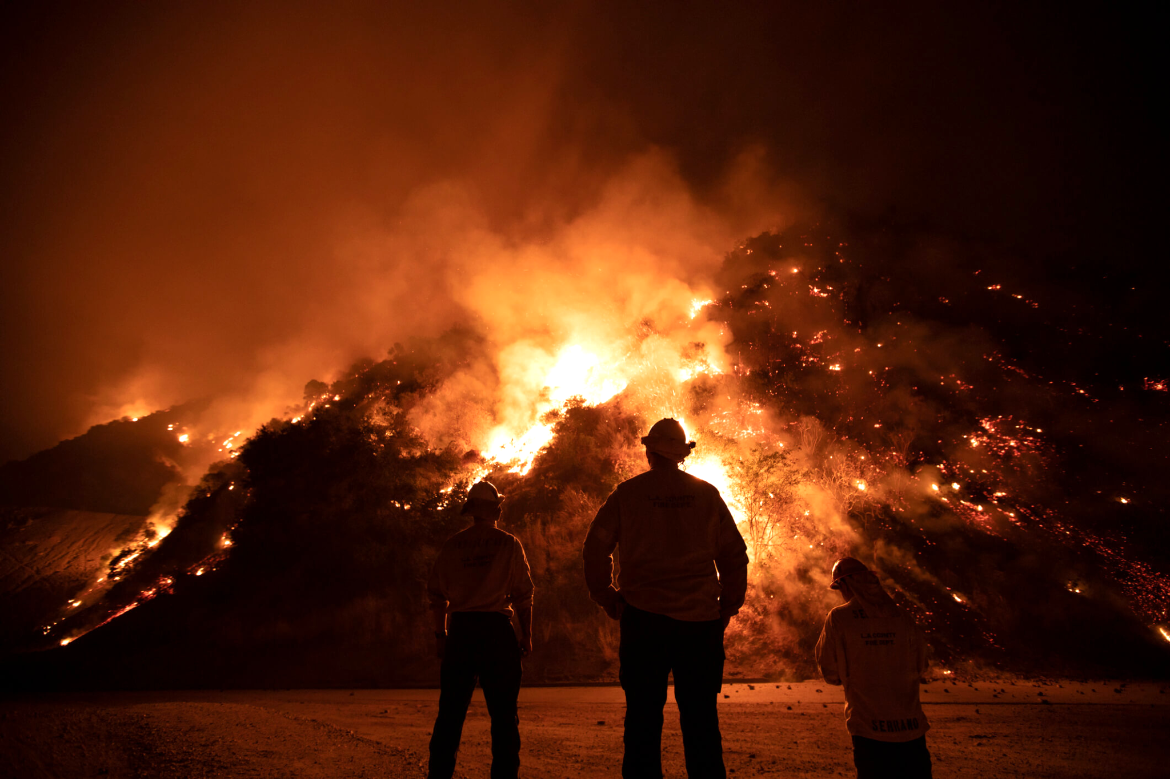
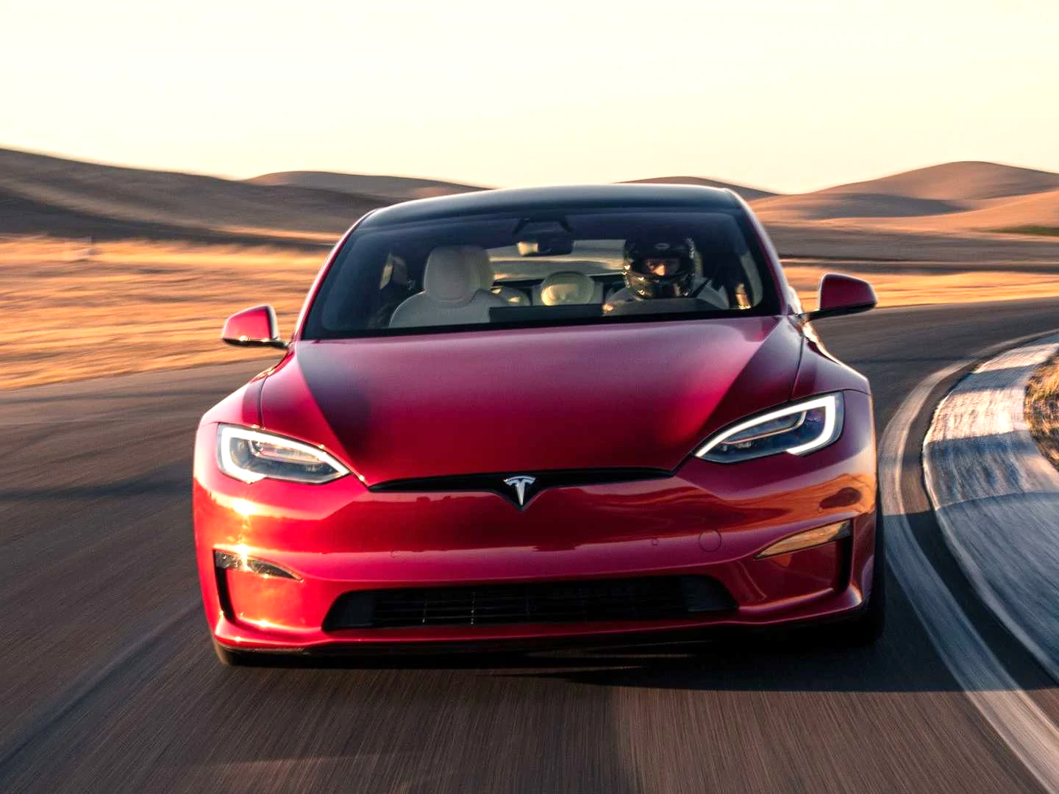
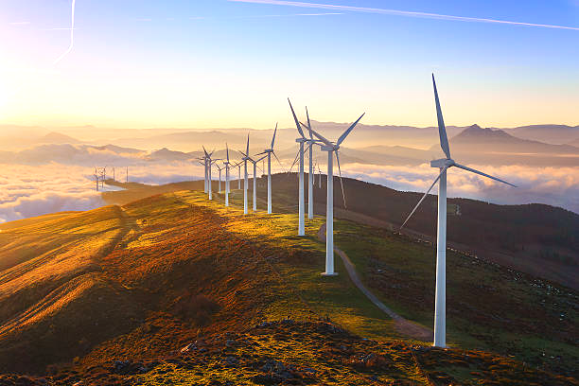
Climate Change
E-Mobility
Network Infrastructure
Energy & transport sector responsible for > 50% of global CO2 emissions
Achieving the 2 degree target only with disruptive solutions in both sectors
> 680 thousand e-cars in GER (5x more than 2020)
Changed requirement profile
Larger battery capacities
What if 49 million registered e-cars in GER?
Green transport, but dirty energy supply?
Continued guarantee of energy in other areas as well
Notes:
Sources:
https://repositum.tuwien.at/handle/20.500.12708/9274
https://de.statista.com/statistik/daten/studie/265995/umfrage/anzahl-der-elektroautos-in-deutschland/#:~:text=Die%20Anzahl%20an%20zugelassenen%20Elektroautos,Bestand%20belief%20sich%20am%201.
https://link.springer.com/chapter/10.1007/978-3-658-17313-5_5
https://de.statista.com/statistik/daten/studie/167957/umfrage/verteilung-der-co-emissionen-weltweit-nach-bereich/
https://de.statista.com/statistik/daten/studie/12131/umfrage/pkw-bestand-in-deutschland/
Img 1: https://www.shelterbox.de/wp-content/uploads/2020/09/waldbrand-kalifornien-feuerwehrleute-bobcat-fire.jpg
Img 2: https://cdn.motor1.com/images/mgl/Q12M1/s1/4x3/2021-tesla-model-s-plaid.webp
Img 3: https://media.istockphoto.com/photos/wind-turbines-in-oiz-eolic-park-picture-id505412046?k=20&m=505412046&s=612x612&w=0&h=Kl6u9oIz29LLWRDx6B-YQ_OVnkL3ycwJfqveY-LgnKo=

Slide 3







Charge Management & Network Infrastructure
The BMVI's Scientific Advisory Board identified the following challenges:
Charging during peak hours
Expansion of the network infrastructure
Ensure free mobility
Increased demand may be difficult to meet with renewable energy sources
Examine need and organizational models for charging infrastructure
Grid stability: ensuring energy supply in other areas as well
Consider network limitations
Notes:
Content:
https://www.bmvi.de/SharedDocs/DE/Anlage/G/wissenschaftlicher-beirat-gutachten-2011-2.pdf?__blob=publicationFile

Slide 4





Intelligent Charging Station
Application calculates how long a charging station receives how much power
Distribute fixed charging power as efficiently as possible
No complex departure planning → Just plug and charge
E-cars come at will when a space is available
Notes:
Img 1: https://www.kostad.at/wp-content/uploads/2021/08/Unity20_Wallbox_Branded-1.png
Img 2: https://www.evoto.ca/wp-content/uploads/2020/09/ModelXnoshadow_birdseyeview.png
Img 3: https://cdn.icon-icons.com/icons2/1852/PNG/512/iconfinder-valueserver-4417114_116617.png
Img 4: https://www.freeiconspng.com/thumbs/cloud-icon/cloud-icon-10.png

Slide 5








Reinforcement Learning
Position n
Position 2
How is the state of the environment built?
Position 1
What is the reward?
There is a vehicle on the position (True/False)
Current battery level [kWh]
Which model can be used?
Maximum battery capacity [kWh]
Number of time intervals that a vehicle has already stayed at the position
How is the model trained?
Minimum & maximum charging power [kW]

Slide 6


Reinforcement Learning
How is the state of the environment built?
Agent receives environment state
Reward corresponds to the difference of all battery capacities between the time intervals
What is the reward?
Agent calculates charging power for each position
Which model can be used?
Environment updates the state
How is the model trained?

Slide 7
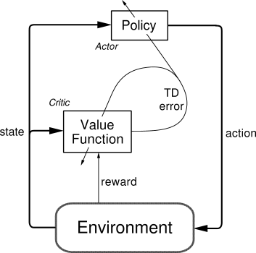
Reinforcement Learning
Classical DQNs are not able to make continuous predictions ...
How is the state of the environment built?
Deep Deterministic Policy Gradient
What is the reward?
Which model can be used?
Actor
Critic
How is the model trained?
Decides which action is to be performed
Evaluates the action of the actor and specifies how this action should be adjusted
Notes:
Img 1: https://miro.medium.com/max/353/0*PhUWeSkXpKxG0rLZ.png

Slide 8
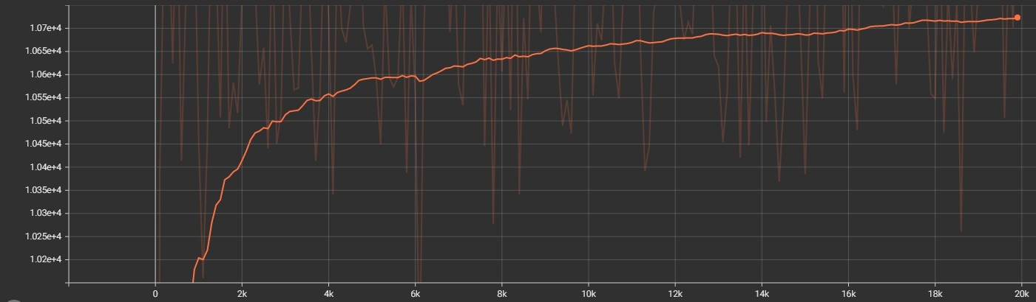
Reinforcement Learning
How is the state of the environment built?
Using the Epsilon-Greedy method, a basic set of experience is initially accumulated during training, until gradually the agent makes more and more frequent decisions...
Decisions are temporarily stored in the replay buffer (queue)
More stable learning through target and train models
What is the reward?
Which model can be used?
How is the model trained?

Slide 9











Architecture & Technology Stack
Webapp
Frontend
Webapp
API
Environ-ment
FCFS
Developer
UI
Agent .
DDPG
Presentation
Interface
Server
Notes:
Img 1: https://upload.wikimedia.org/wikipedia/commons/thumb/c/cf/Angular_full_color_logo.svg/1200px-Angular_full_color_logo.svg.png
Img 2: https://play-lh.googleusercontent.com/keVVojxW-b11NTKWZg8GulfLlhqBpATvqGFViblYsI0fxW_8a0sIPgyRlB94Gu1AQMY
Img 3: https://upload.wikimedia.org/wikipedia/commons/thumb/1/10/PyTorch_logo_icon.svg/1200px-PyTorch_logo_icon.svg.png
Img 4: https://play-lh.googleusercontent.com/BbuKPu-946B_nkgFYcE4Y-uxbfoUm8SWNM4j7jMWoCS-jk8TFQWeLTfbLsn6umaQn38
Img 5: https://upload.wikimedia.org/wikipedia/commons/thumb/8/84/Matplotlib_icon.svg/1024px-Matplotlib_icon.svg.png
Img 6: https://upload.wikimedia.org/wikipedia/commons/thumb/c/c3/Python-logo-notext.svg/2000px-Python-logo-notext.svg.png
Img 7: https://user-images.githubusercontent.com/50221806/86498201-a8bd8680-bd39-11ea-9d08-66b610a8dc01.png
Img 8: https://upload.wikimedia.org/wikipedia/en/b/b9/Nvidia_CUDA_Logo.jpg+
FCFS = First Come First Serve

Slide 10
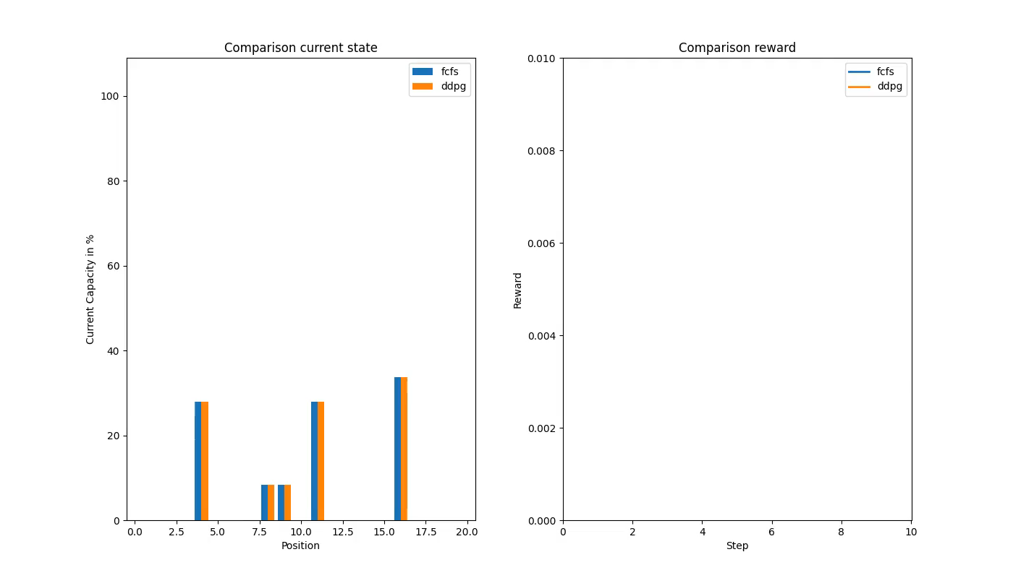
Results

Slide 11






Conclusion
Achievement of Objectives
Working AI system
Usable frontend
A "functioning" PoC can be presented to potential investors
Critical Assessment
FCFS is not the most intelligent non-AI algorithm
Certain bias due to low diversity of variants during training
Battery research still in early stages → disruptive techniques may render our platform unusable

Slide 12

Demo

Slide 13
Titel | Approach | Difference to our use case
Intelligent Electric Vehicle Charging Recommendation Based on Multi-Agent Reinforcement Learning (Link) | each charging station corresponds to its own RL agent Consideration of other influences such as charging competition or delayed access strategies. Results from a conducted experiment are promising | The paper is primarily about the generation of recommendations regarding a suitable charging station, which is based on a pool of geographically distributed charging stations.
Optimal Placement of Public Electric Vehicle Charging Stations Using Deep Reinforcement Learning (Link) | Using projected charging demand and current charging stations to find an optimal location for new charging stations. Factors: traffic density in the surrounding area, the registration of e-vehicles & proximity to certain types of public buildings. | It is primarily about finding new charging stations
Smart charging of electric vehicles using reinforcement learning (Link) | The problem to be addressed is to ensure grid stability, taking into account the charging behavior and the overall cost minimization, which is composed of supply and demand An RL agent is designed to learn the consumption behavior of households, which takes into account the goal of individual welfare maximization Results of the experiment are promising and based on statistical customer models The agent was able to reduce energy prices and at the same time reduce the general load including peak loads in the grid | In our use case, the focus is not exclusively on reducing energy prices, but on the intelligent distribution of resources

Slide 14
Titel | Approach | Difference to our use case
Deep reinforcement learning for energy management in a microgrid with flexible demand (Link) | Optimized resource allocation within a novel microgrid model consisting of wind turbines, energy storage systems, a set of thermostatically controlled consumers, a set of price-dependent consumers, and a connection to the main grid Several DL approaches were tested within one experiment The best results were achieved by an "asynchronous advantage actor-critic" model, which makes additional use of "experience replay" | The focus is again on the price component, which must be optimized first and foremost Electric vehicles pose a certain challenge because they can disconnect from the microgrid at any time → Electric vehicles were explicitly not considered in the paper
Applications of reinforcement learning in energy systems (Link) | Paper is a literature review on reinforcement learning managing power systems State-of-the-art methods such as Actor-Critic were rarely used in experiments, which according to the authors, resulted in severe performance degradation Multi-agent RL does offer a lot of potential, finding solutions to complex interaction problems between multiple parties → nevertheless, certain methods from this field were not used Conclusion: RL has a lot of potential to solve power distribution problems efficiently

Slide 15
Titel | Approach | Difference to our use case
Deep Reinforcement Learning for Smart Home Energy Management (Link) | Energy cost minimization for a smart home without a model of the building's thermal dynamics considering a comfortable temperature range Energy-related challenges: Renewable energy performance, non-shiftable electricity demand, outdoor temperature, and electricity price Energy system owns storage, consumers and generators Within an experiment, a Markov decision process and a Deep Deterministic Policy Gradients (DDPG) were implemented and compared to each other According to the authors, DDPG is comparatively effective and robust | Consumers are permanently connected to the power grid not like electric vehicles Cost minimization is again in the foreground
Advertising space for rent - Here could be your advertisement.
Smart Grid Optimization by Deep Reinforcement Learning over Discrete and Continuous Action Space (Link) | Comparison of procedures for discrete and continuous action spaces that pursue the goal of meeting energy needs by means of different energy suppliers (external & internal). | the goal of the model proposed by the authors is only to decide to buy or sell energy (in the continuous action space: how much to buy or sell) → not compatible with our problem definition

Slide 16
Titel | Approach | Difference to our use case
Deep Reinforcement Learning for Optimal Energy Management of Multi-energy Smart Grids (Link) | Deep reinforcement learning approach for optimal control of multi-energy systems in smart grids. The multi-energy residential microgrid model used here consists of electricity, heating and cooling storage, and thermal production systems and renewable energy generation Challenge: optimal real-time control of multi-energy systems with multiple simultaneous continuous action spaces. A DDPG algorithm was tested in an experiment. It was found that the DDPG agent can handle continuous state and action spaces well | No consideration of electric vehicles

